Slide 1
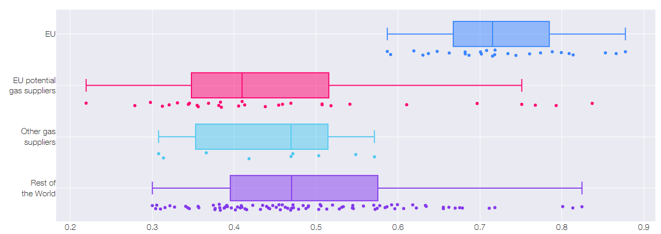
Hungary
Denmark
Russia
Qatar
United States
China
Japan
Switzerland
g

